Slide 1

Ministry of AYUSH
IMPLEMENTATION STRATEGY OF BUDGET ANNOUNCEMENTS 2021-22
WEBINAR ON 23.02.2021

Slide 2
EMERGING ROLE OF AYUSH IN PUBLIC HEALTH
101 Integrated AYUSH Hospitals supported under National AYUSH MISSION (NAM)
Holistic wellness Model
launch of 12500 AYUSH Health & Wellness Centres under AYUSHMAN Bharat
Global recognition of Yoga for well being -International Day of Yoga on June 21
Establishment of Pharmacopeia Commission of Indian Medicine and Homeopathy for Standardisation & Quality Control of AYUSH drugs
Nationwide digital platform called “AYUSH GRID” – to bring onboard all AYUSH facilities, hospitals, laboratories and its alignment with NDHM.
Upgradation of Educational Institutes:
-INI at Jamnagar
-Deemed University at Jaipur
-Other National Institutes at advanced stage of Deemed University.
Setting up of satellite campuses of National Institutes for excellence in teaching and research

Slide 3
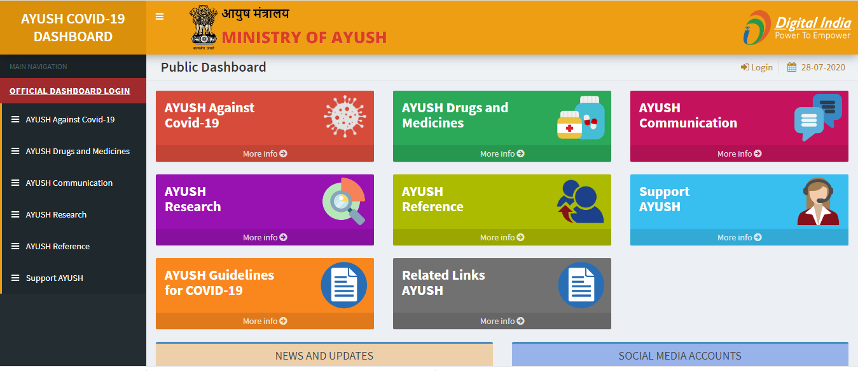


AYUSH RESPONSE DURING COVID-19 PANDAMIC
Issuing Advisories & immunity care guidelines
Training programs on COVID to develop master trainers across the states.
Industry facilitation in collaboration with Ministry of Home Affairs.
Research Notification and call for proposals
Constitution of Interdisciplinary Task Force and undertaking research studies
Establishment of PMU to fast track the research proposals
Establishment of Fever clinics.
Distribution of PPE kits and ventilators
National Protocol for management of covid-19 through Ayurveda & Yoga

Slide 4
PROGRESSIVE ALLOCATION & EXPENDITURE IN AYUSH

Slide 5
Major initiatives proposed in Budget 2021-22 and in subsequent years.
National AYUSH Mission-2.0 as Centrally Sponsored Scheme
  12,500 AYUSH Health & Wellness centres to be operationalised
  Establishment of 100 integrated AYUSH Hospitals at district level
  Focus on mainstreaming of AYUSH by public health initiatives like Chalo Bharat Abhiyan, Ayur Poshan, Supraja, Vayomitra etc.
“Pradhan Mantri Vriksh AYUSH Yojana” for promotion of Herbal Cultivation under “Atma Nirbhar Bharat ”Financial Package announced by Finance Minister in May,2020.
Focus on completion of 4 satellite campuses of National Institutes for quality Education and Research

Slide 6
Major initiatives proposed in Budget 2021-22
Contd/-
Strengthening of IT infrastructure in AYUSH Sector through AYUSH GRID.
WHO Global Centre for Traditional Medicine in India.
Champions Services Sector Scheme to establish super speciality AYUSH Hospitals in private Sector, skill development in AYUSH Sector to meet the domestic and International requirements.
Initiative to promote investment in AYUSH Sector through Invest India’s “Strategic Policy and Facilitation Bureau” in Ministry of AYUSH.
Constitution of NCISM and NCH to improve quality and standards of AYUSH Education.

Slide 7
PM Vriksh AYUSH Yojana (PM-VAY)
Under Atma Nirbhar Bharat Financial Package announced by Finance Ministry
Rs.4000 crores financial package under Atma Nirbhar Bharat to promote cultivation, post harvest management and marketing of high value medicinal plants.
10 lakh ha. of farm land to be brought under cultivation in cluster approach involving farmers, FPOs and AYUSH entrepreneurs.
800 ha. area to be covered along banks river Ganga under National Mission on Clean Ganga.
Emphasis on post harvest management for value addition, quality improvement and enhanced financial benefits to farmers.
Backward integration with AYUSH industry.

